Slide 1

Hip tibias adipocytes and pellets analysis
28.07.2025

Slide 2
Changes
Logcpm → for all, prediction and pca
Pca(transpose) → on logcpm → and samples as rows and genes as samples.
This would stabilze the PCA representations… “could have been useful to do for sample selection”…
Does not affect results of Differential expression analysis.

Slide 3
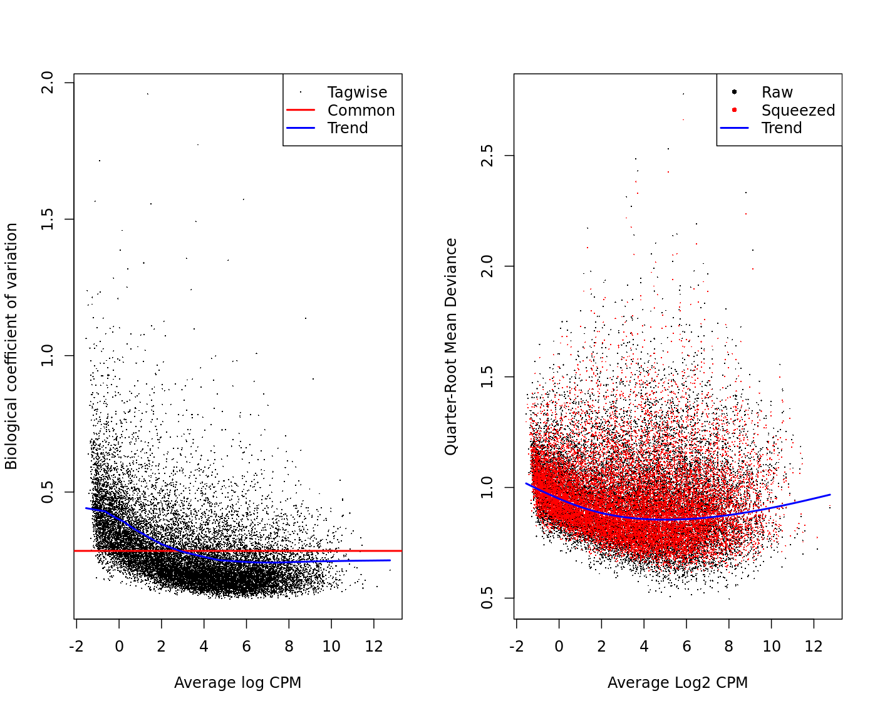
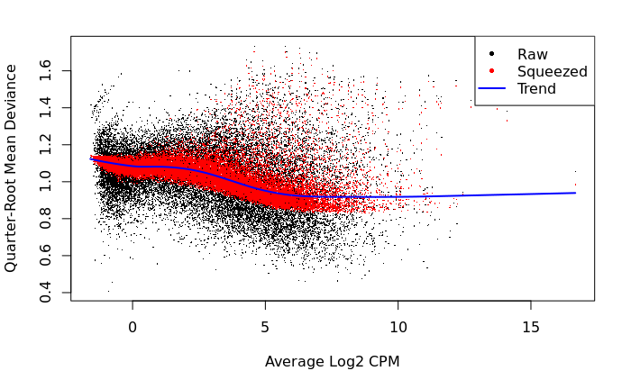
Dispersion.
Usually the more highly expressed less dispersion… here is changed.

Slide 4
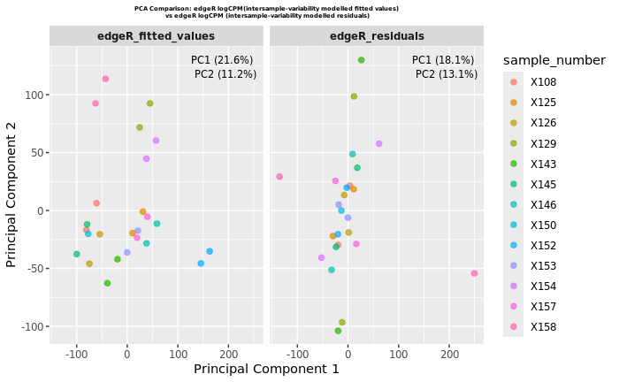
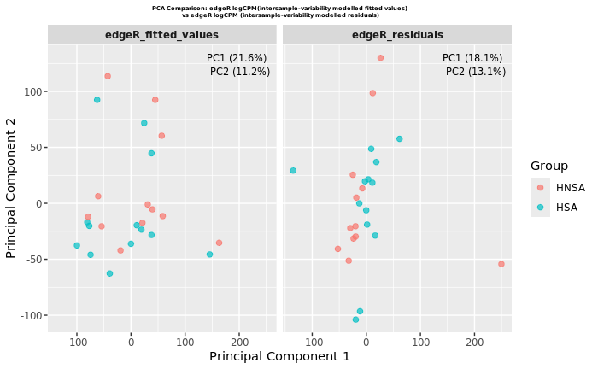
What did edgeR model and what did not-model
Fitted shall separate HNSA vs HAS and paired patients, while residuals what did not the model learn as we modeled is any other batch or feature besides this two above.
Implemented for only one comparison here.

Slide 5
RF with 2k genes f-test non paired design
Remove low variable genes → select 2000 F-test genes using →
~ 0 + group (sclerotic vs non.sclerotic)
downside: captures intersample genes
Alternatives:
Remove low variable genes → select 2000 F-test genes using limma or edgeR or DESeq2 with the formula: ~0+ patient + group (patient modelled and sclerotic vs non.sclerotic)
captures similar genes to DEA (less variable genes but more predictive power)
Train model on 2k genes + Age + Gender + BMI + oarsi_score

Slide 6
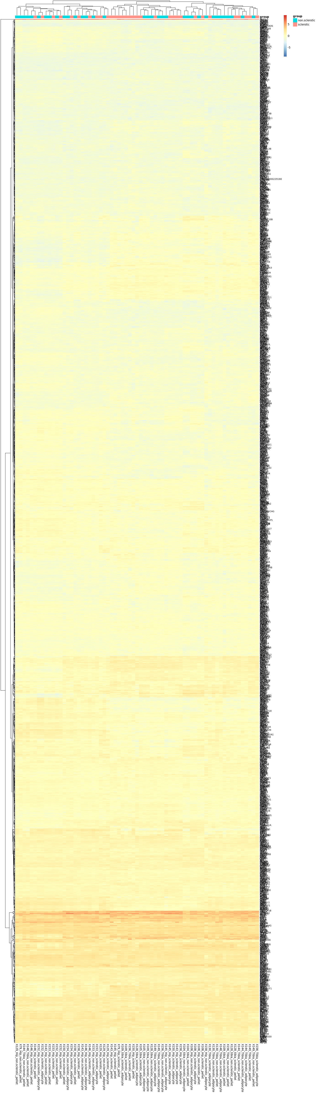
RF with OARSI score
Remove low variable genes
select 2000 F-test genes from limma ~0+patient+group
Train RF model on 2k genes + Age + Gender + BMI + oarsi_score

Slide 7
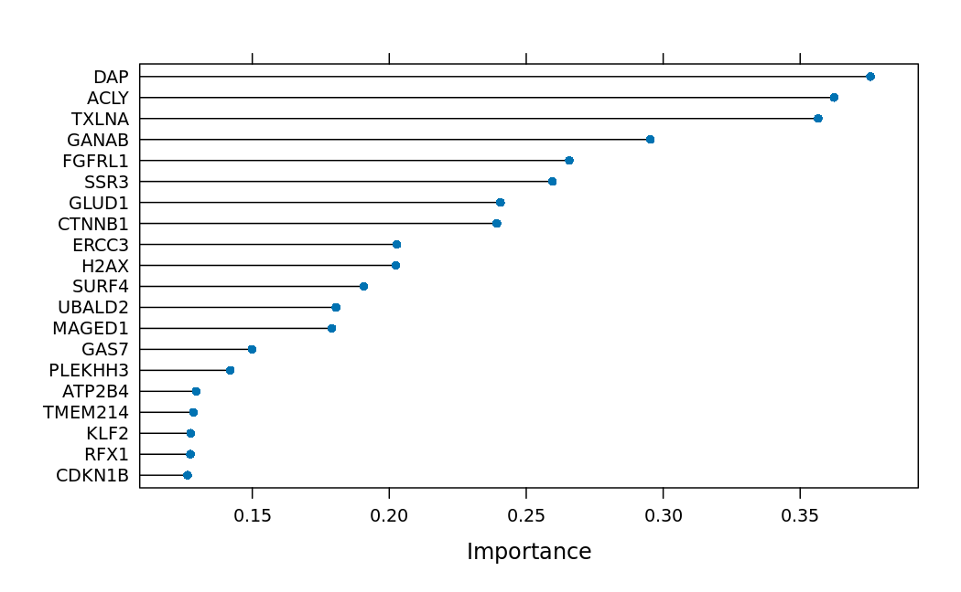
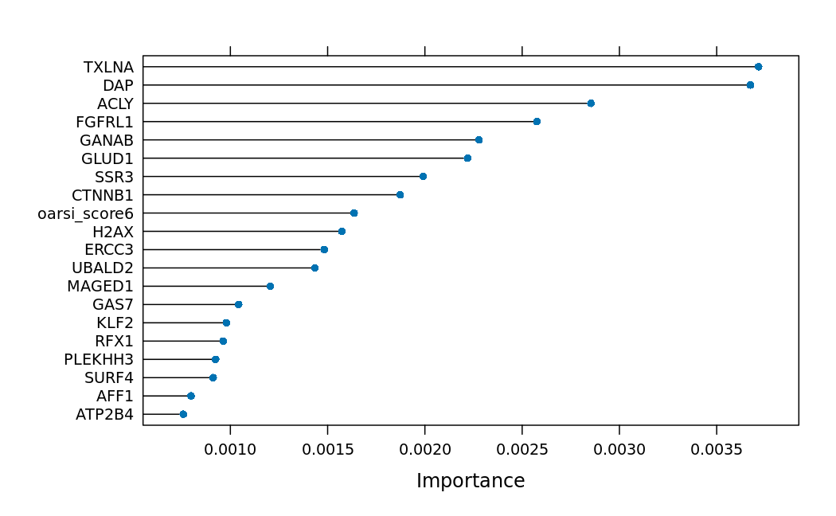
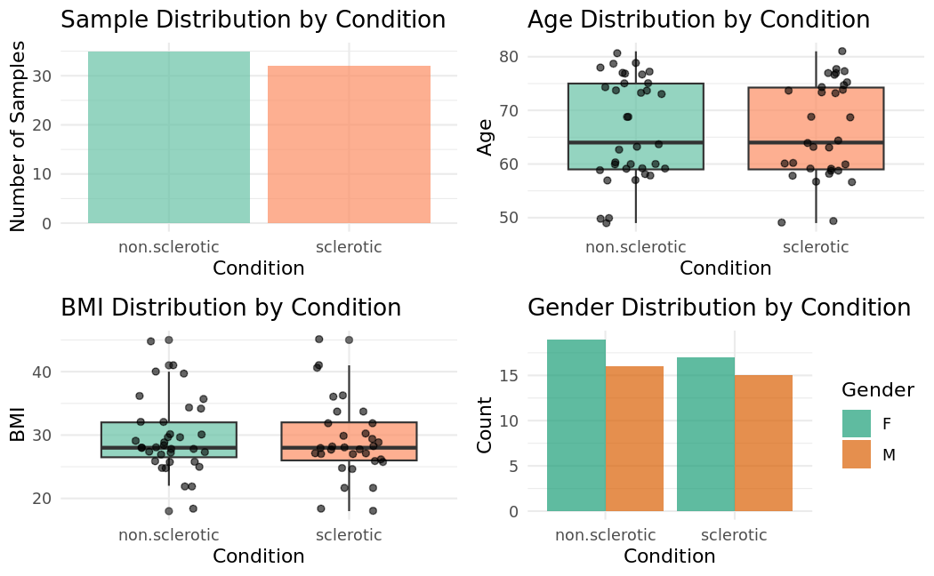
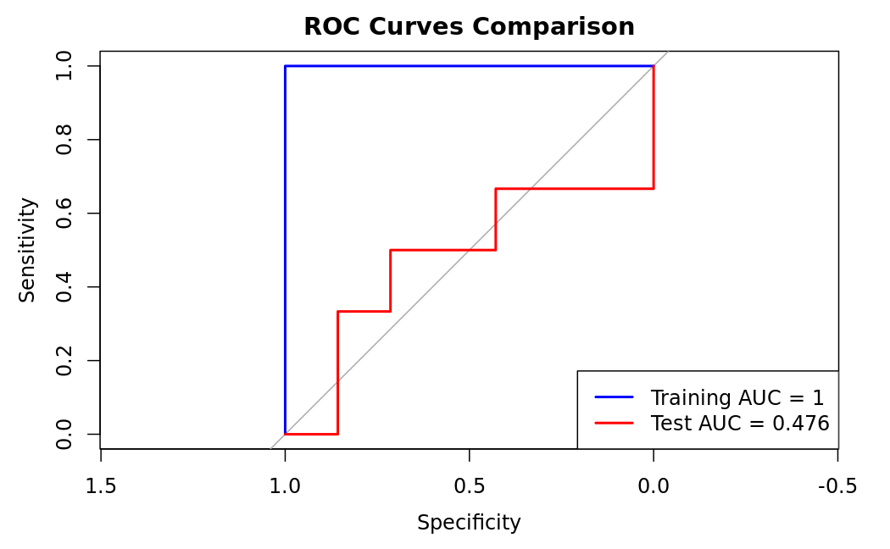
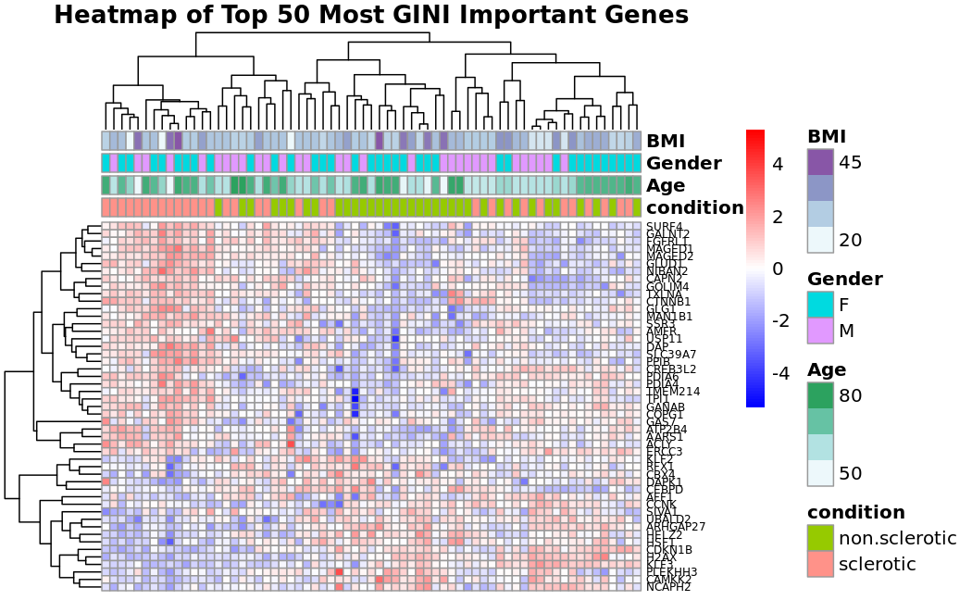
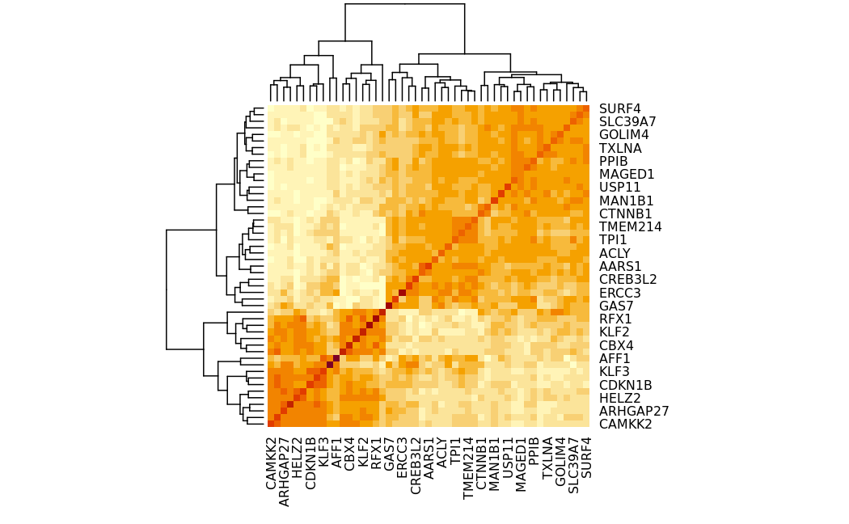
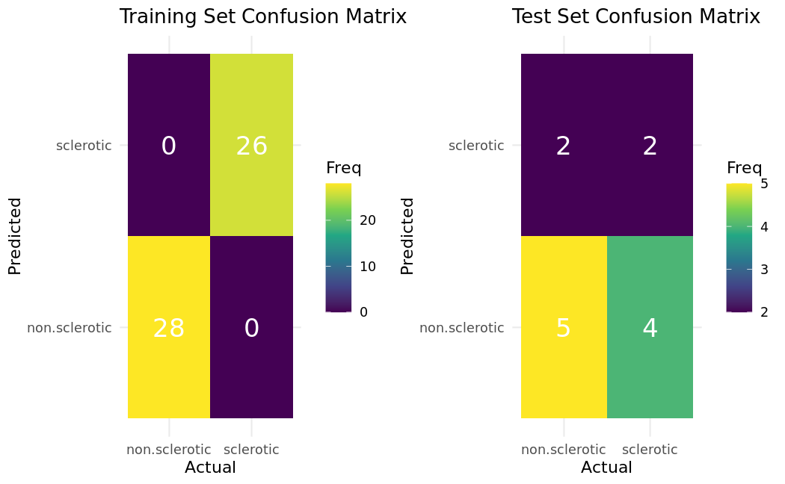
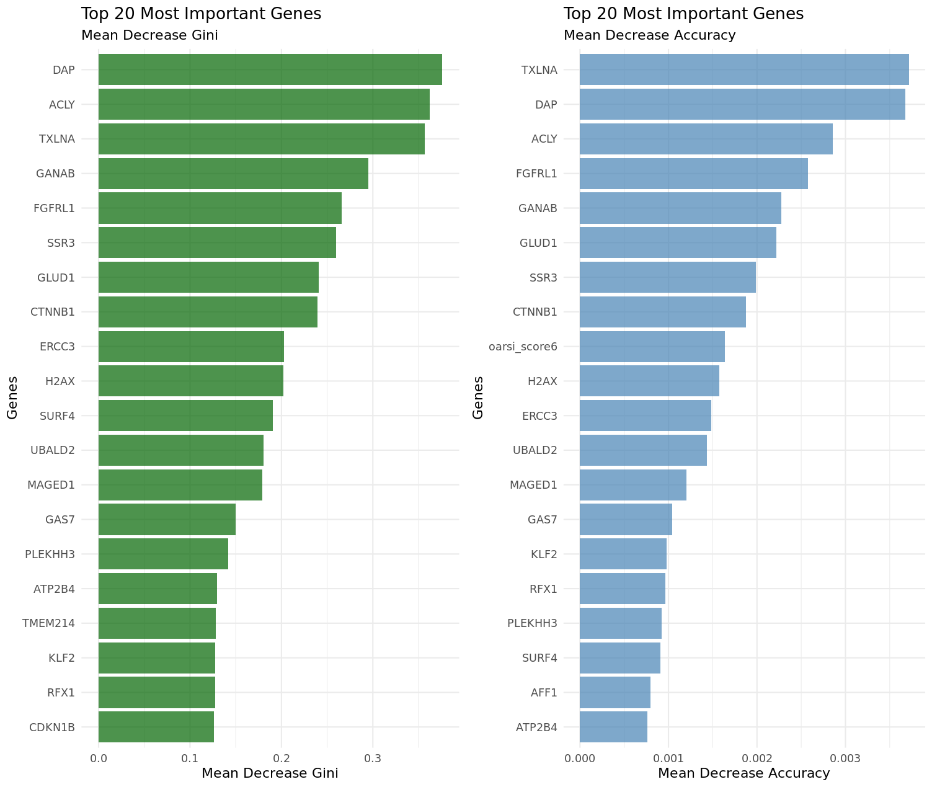
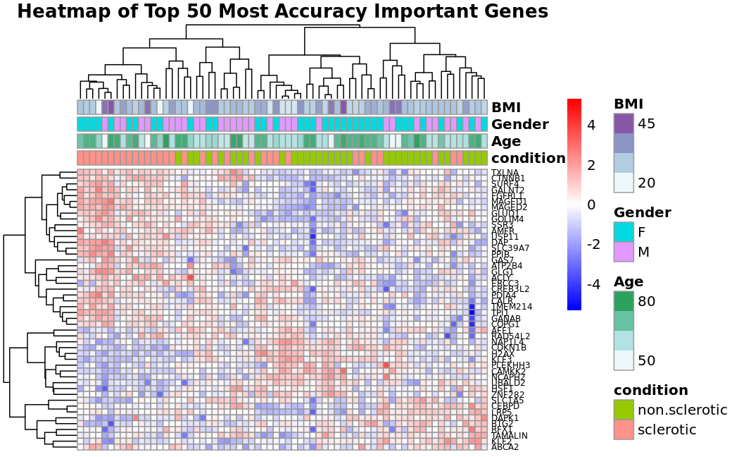
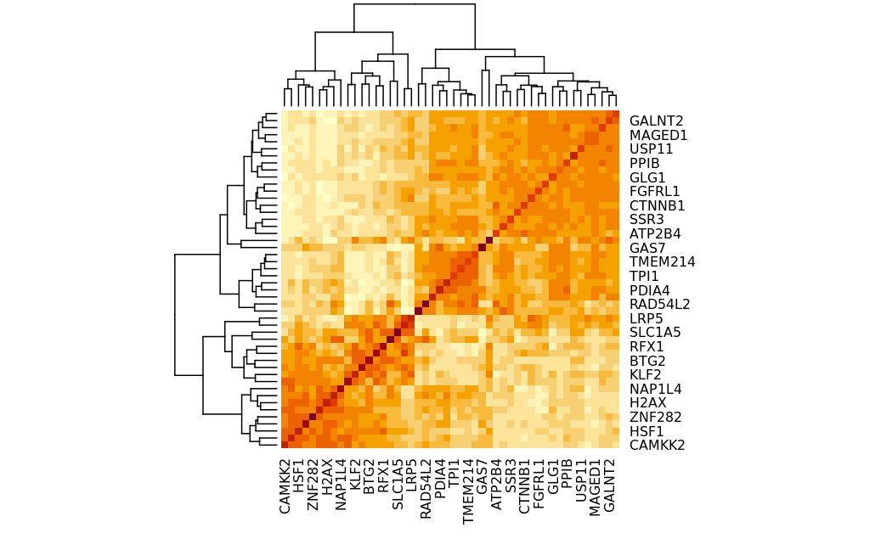
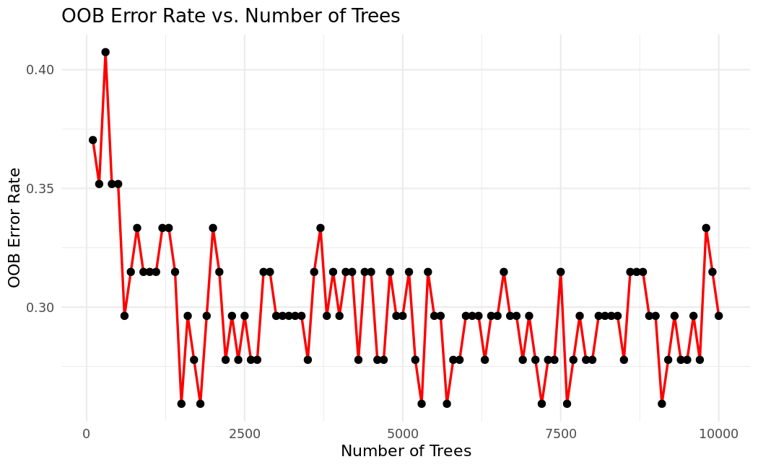
RF model of «all samples with OARSI score» + 2k genes
MDG(gini) MDA (accuracy)
Model Results Training
MDG Gini
MDA (accuracy)
The higher the more important the feature for next split MDG(gini) or for the model when removed MDA (accuracy)
Notes:
Gini: variable that helps to split (good when we dont have too many categories or continuos values to predict) (MDG) the higher the most important for the node split..
Accuracy: permutation → good when a lot of categories or continuous values topredict) how important is this feature for the model when permuted. (MDA) the higher the value the most important for the model
TRAINING.: 28 non.sclerotic 26 sclerotic
TEST: 7 non.sclerotic 6 sclerotic

Slide 8
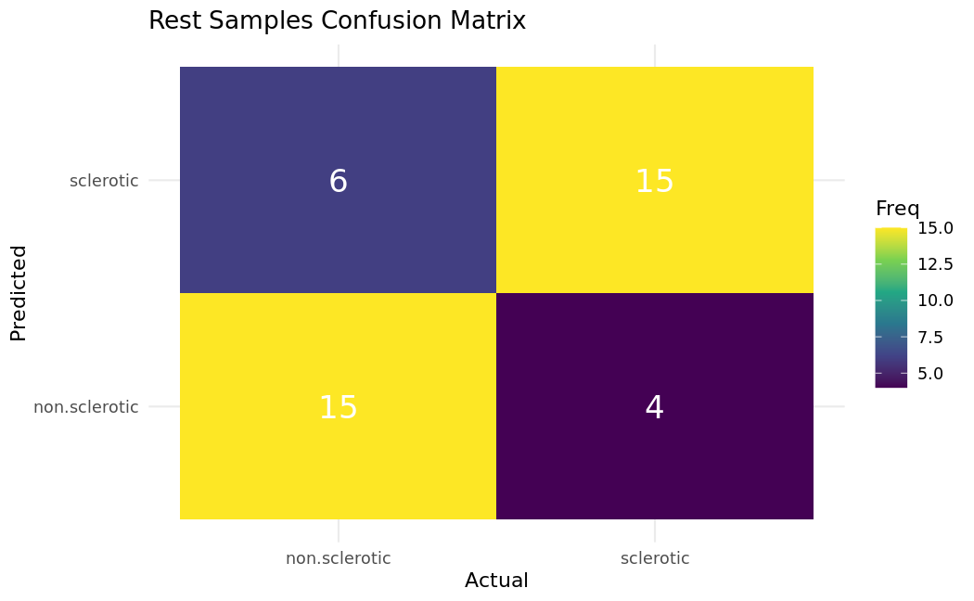
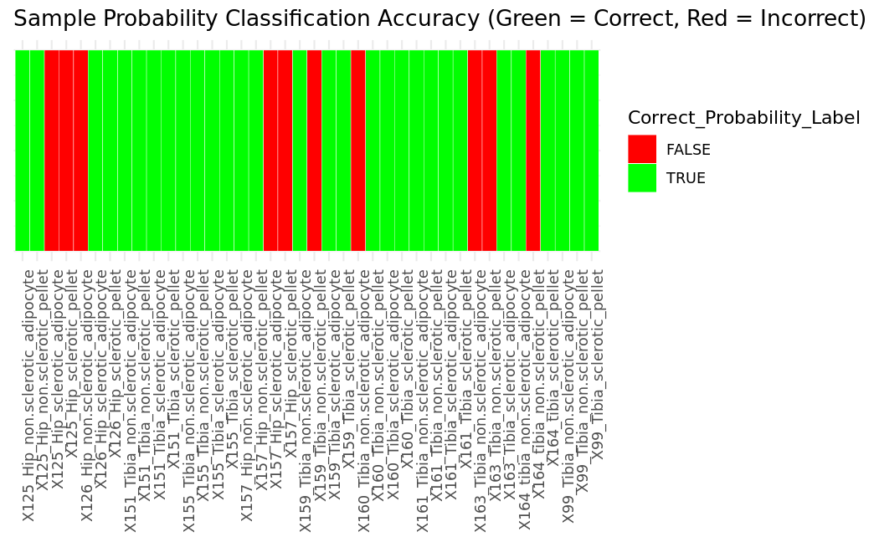
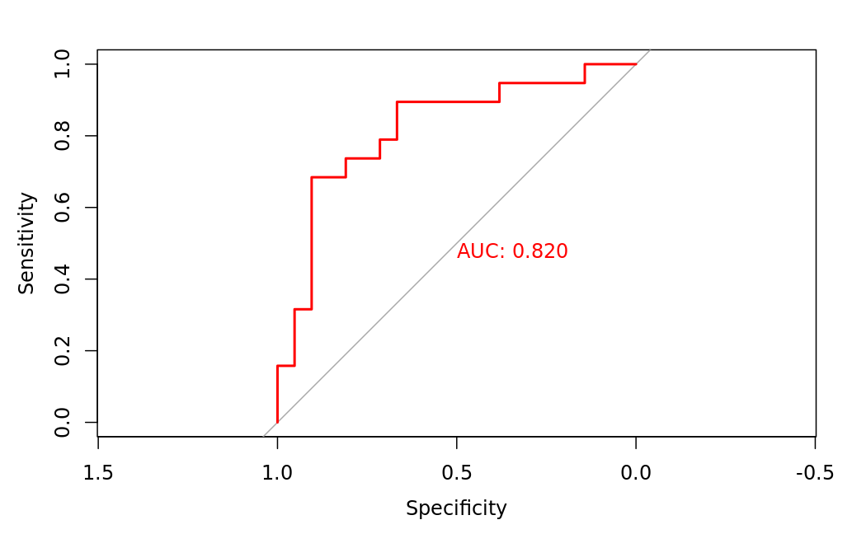
RF model of «all samples with OARSI score» + 2k genes
Model Prediction Results
Notes:
Gini: variable that helps to split (good when we dont have too many categories or continuos values to predict) (MDG) the higher the most important for the node split..
Accuracy: permutation → good when a lot of categories or continuous values topredict) how important is this feature for the model when permuted. (MDA) the higher the value the most important for the model

Slide 9
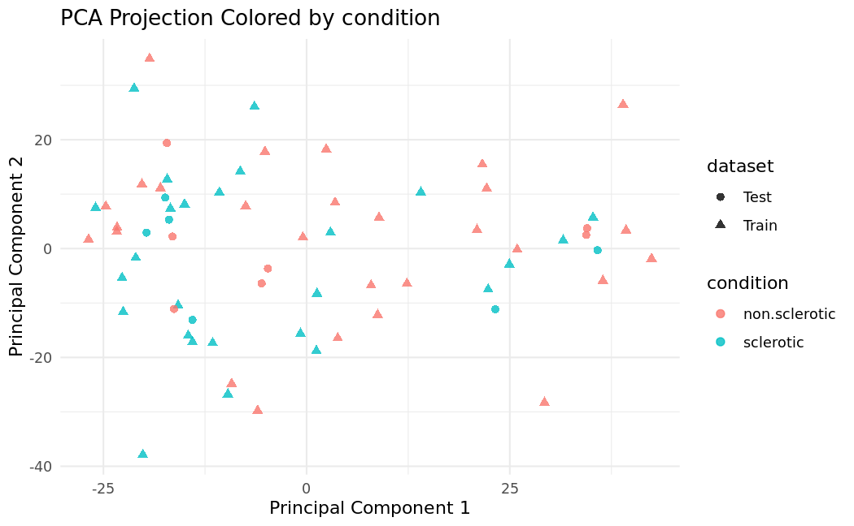
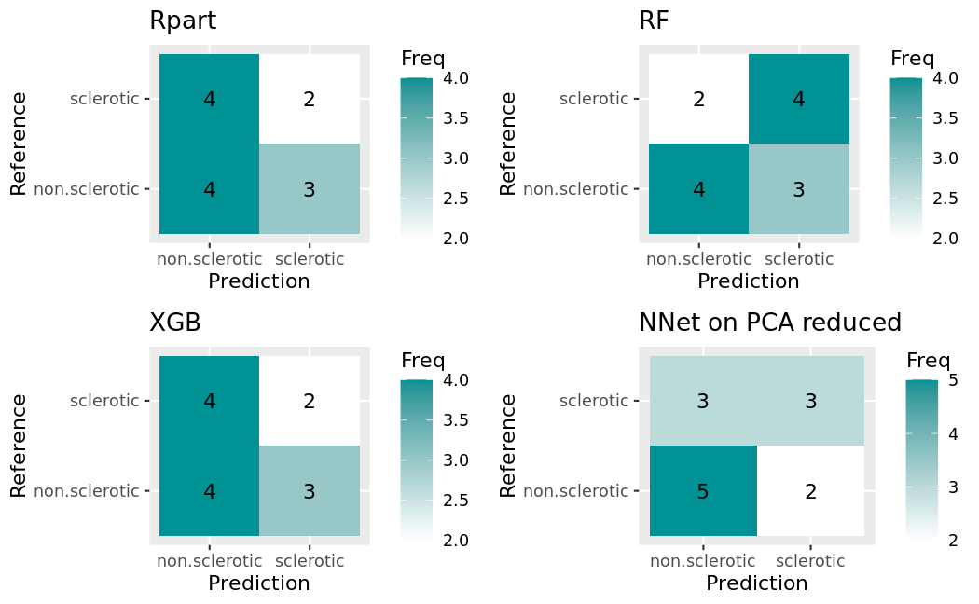
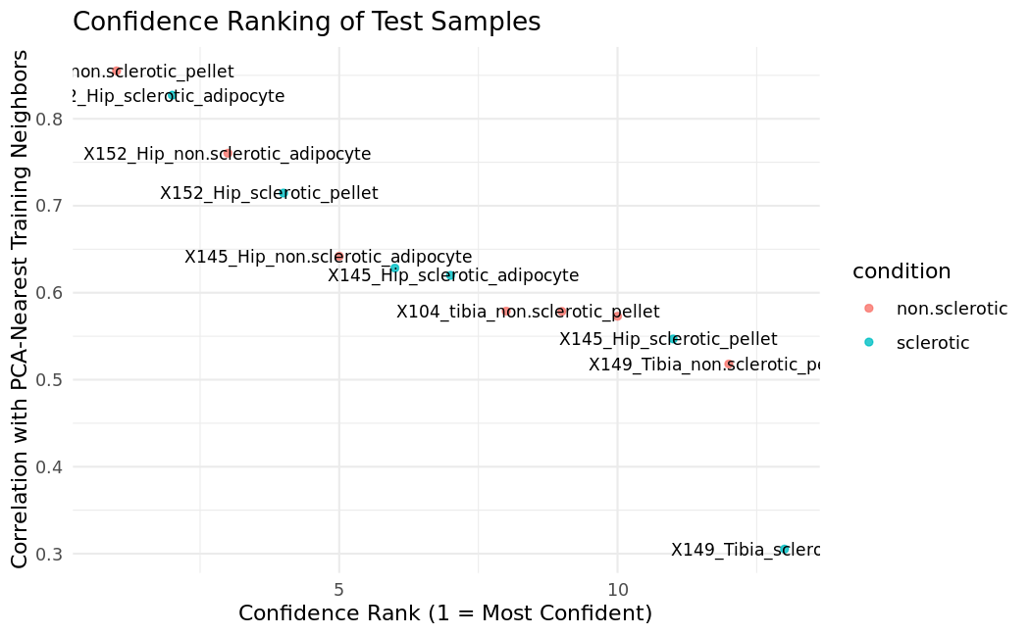
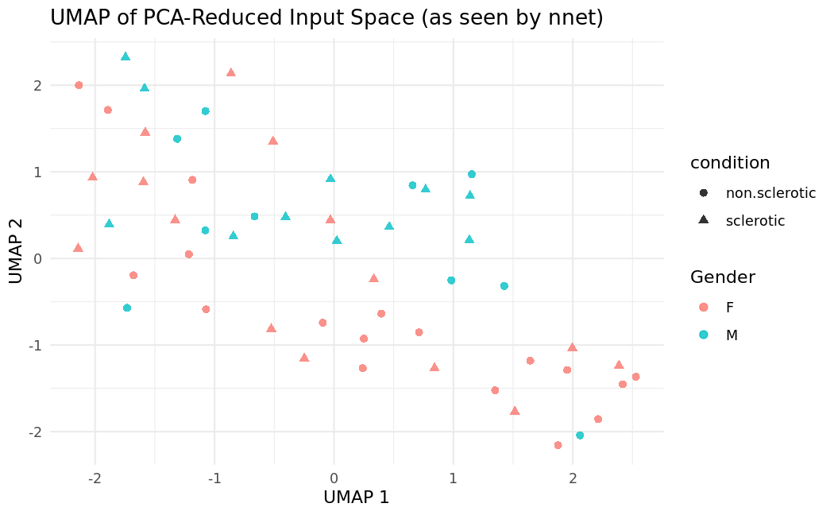
Other models(nnet in R.. Cant see embeddings).
samples

